Slide 1
18ITT42 - DESIGN AND ANALYSIS OF ALGORITHMS
(IV-Semester)
Velalar College of Engineering and Technology
(Autonomous)
Department of CSE
(Accredited by NBA)
Handled By:
Dr.V.Latha Jothi , Professor

Slide 2
UNIT – 1 ALGORITHM ANALYSIS
Introduction : Notion of Algorithm – Fundamentals of Algorithmic problem Solving – Important Problem types.
Fundamentals of the Analysis of Algorithm Efficiency : Analysis Framework – Asymptotic notations and Basic Efficiency Classes - Mathematical Analysis of Recursive and Non-recursive algorithms-Empirical analysis of Algorithms-Algorithm Visualization

Slide 3
Worst-Case, Best-Case, and Average-Case Efficiencies
The study of change in performance of the algorithm with the change in the order of the input size is defined as asymptotic analysis.
Asymptotic notations are the mathematical notations used to describe the running time of an algorithm when the input tends towards a particular value or a limiting value
Measuring the running time is expressed as the order of n/n²/…. i.e. as some function
We can compare any two algorithms by comparing their order of growth

Slide 4
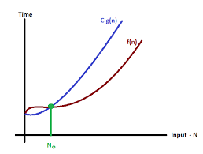
Asymptotic Notations and Basic Efficiency Classes
O-notations
A function f(n) is said to be in O(g(n)), denoted f(n) ∈ O(g(n)), if f(n) is bounded above by some constant multiple of g(n) for all large n, i.e., if there exist some positive constant c and some non-negative integer n₀ such that
f(n) ≤ cg(n) for all n ≥ n₀
Eg:
100n + 5 ≤ 100n + n (for all n ≥ 5)
= 101n ≤ 101 n² (here c = 101 and n₀ = 5)
Here 100n + 5 ≤ 101 n² i.e. 100n + 5 ∈ O(n²)
100n + 5 ≤ 100n + n (for all n ≥ 5)
= 101n + 5n = 105n ≤ 105 n² (here c = 105 and n₀ = 1)
Here 100n + 5 ≤ 10 n² i.e. 100n + 5 ∈ O(n²)

Slide 5
Properties involving Asymptotic Notations
If t₁(n) ∈ O(g₁(n)) and t₂(n) ∈ O(g₂(n)), then
t₁(n) + t₂(n) ∈ O(max{g₁(n), g₂(n)})
Since t₁(n) ∈ O(g₁(n)), there exist some positive constant c₁ and some non-negative integer n₁ such that
t₁(n) ≤ c₁g₁(n) for all n ≥ n₁
Similarly, Since t₂(n) ∈ O(g₂(n)), there exist some positive constant c₂ and some non-negative integer n₂ such that
t₂(n) ≤ c₂g₂(n) for all n ≥ n₂
Let c₃ = max{c₁, c₂} and consider n ≥ max{n₁, n₂}
t₁(n) + t₂(n) ≤ c₁g₁(n) + c₂g₂(n)
≤ c₃g₁(n) + c₃g₂(n)
≤ c₃2 max[g₁(n), g₂(n)]
Therefore, t₁(n) + t₂(n) ∈ O(max{g₁(n), g₂(n)}),
here c = 2c₃ = 2 max{c₁, c₂} &
n = max{n1, n2}

Slide 6
Properties involving Asymptotic Notations
If t₁(n) ∈ O(g₁(n)) and t₂(n) ∈ O(g₂(n)), then
t₁(n) + t₂(n) ∈ O(max{g₁(n), g₂(n)})
Since t₁(n) ∈ O(g₁(n)), there exist some positive constant c₁ and some non-negative integer n₁ such that
t₁(n) ≤ c₁g₁(n) for all n ≥ n₁
Similarly, Since t₂(n) ∈ O(g₂(n)), there exist some positive constant c₂ and some non-negative integer n₂ such that
t₂(n) ≤ c₂g₂(n) for all n ≥ n₂
Let c₃ = max{c₁, c₂} and consider n ≥ max{n₁, n₂}
t₁(n) + t₂(n) ≤ c₁g₁(n) + c₂g₂(n)
≤ c₃g₁(n) + c₃g₂(n)
≤ c₃2 max[g₁(n), g₂(n)]
Therefore, t₁(n) + t₂(n) ∈ O(max{g₁(n), g₂(n)}),
here c = 2c₃ = 2 max{c₁, c₂} &
n = max{n1, n2}
when an algorithm is divided into phases it is not sum of g₁(n) & g₂(n) is useful for the upper bound, but the maximum of g₁(n), g₂(n) decides the upper bound

Slide 7
Asymptotic Notations and Basic Efficiency Classes
Ω-notation
A function f(n) is said to be in Ω(g(n)), denoted by f(n) ∈ Ω(g(n)), if f(n) is bounded below by some constant multiple of g(n) for all large n, i.e., if there exist some positive constant c and some non-negative integer n₀ such that
f(n) ≥ cg(n) for all n ≥ n₀
Eg: prove n³ ∈ Ω (n²)
n³ ≥ n² (for all n₀ = 0 and c = 1)
Here n³ ≥ n² i.e. n³ ∈ Ω (n²)

Slide 8
Asymptotic Notations and Basic Efficiency Classes
Θ-notation
A function f(n) is said to be in Θ(g(n)), denoted by f(n) ∈ Θ(g(n)), if f(n) is bounded both above and below by some constant multiples of g(n) for all large n, i.e., if there exist some positive constant c₁ and c₂ and some non-negative integer n₀ such that
c₁g(n) ≤ f(n) ≤ c2g(n) for all n ≥ n₀
Prove n(n-1) ∈ Θ n²
To prove right inequality
(½)n(n-1) = (½) n²- (½) n ≤ (½) n²
To prove left inequality
(½)n(n-1)=(½)n²-(½)n ≥ (½)n²-(½)n*(½)n ≥ ¼ n^{2,} here c₂= ¼, c₁ = ½, and n₀ = 2.
Hence ¼ n² ≤ ½ n(n-1) ≤ ½ n²

Slide 9
Comparison of O, Ω & Θ notations
Big O | Big Ω | Big Θ
Rate of growth of an algorithm is less than or equal to a specific value. | Rate of growth is greater than or equal to a specified value | Rate of growth is equal to a specified value
The upper bound of algorithm is represented by Big O notation | The algorithm’s lower bound is represented by Omega notation | The bounding of function from above and below is represented by theta notation
Big oh (O) – Upper Bound | Big Omega (Ω) – Lower Bound | Big Theta (Θ) – Tight Bound
upper bound on an algorithm is the most amount of time required (worst case) | lower bound on an algorithm is the least amount of time required (best case). | tightest bound is the best of all the worst case times that the algorithm can take.
Mathematically: Big Oh is f(n) <= Cg(n) for all n >= n0 | Mathematically: Big Omega is Cg(n) <= f(n) for all n >= n0 | Mathematically – Big Theta is C2g(n) <= f(n) <= C1g(n) for n >= n0

Slide 10
Master’s Theorem
T(n) = aT(n/b) + f(n), where,
n = size of input
a = number of subproblems in the recursion
n/b = size of each subproblem. All subproblems are assumed to have the same size.
f(n) = cost of the work done outside the recursive call, which includes the cost of dividing the problem and cost of merging the solutions Here, a ≥ 1 and b > 1 are constants, and f(n) is an asymptotic function

Slide 11
Master’s Theorem
T(n) = aT(n/b) + f(n)
where, T(n) has the following asymptotic bounds:
If f(n) = O(n^{log}_{b}^{a-ϵ}), then T(n) = Θ(n^{log}_{b} ª).
If f(n) = Θ(n^{log}_{b}ª), then T(n) = Θ(n^{log}_{b}ª * log n).
If f(n) = Ω(n^{log}_{b}^{a+ϵ}), then T(n) = Θ(f(n)). ϵ > 0 is a
constant.

Slide 12

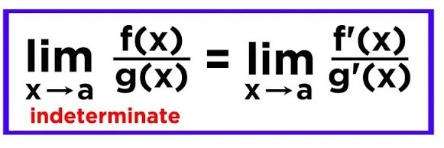

Using Limits for Comparing Orders of Growth
Three principal cases
the first case means that t (n) ∈ O(g(n)),
the last case means that t(n) ∈ Ω(g(n)), and
the second case means that t (n) ∈ Θ (g(n)).
L’Hospital’s rule
Stirling’s formula

Slide 13
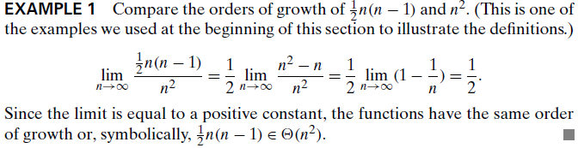
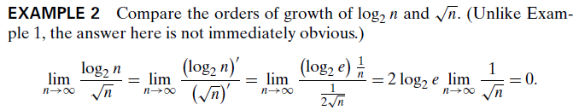
Using Limits for Comparing Orders of Growth

Slide 14
Using Limits for Comparing Orders of Growth
Little-O Notation
For non-negative functions, f(n) and g(n), f(n) is little o of g(n) if and only if f(n) = O(g(n)), but f(n) ≠ Θ(g(n)). This is denoted as
"f(n) = o(g(n))".
Little Omega Notation
For non-negative functions, f(n) and g(n), f(n) is little omega of g(n) if and only if f(n) = Ω(g(n)), but f(n) ≠ Θ(g(n)). This is denoted as
"f(n) = ω(g(n))".

Slide 15
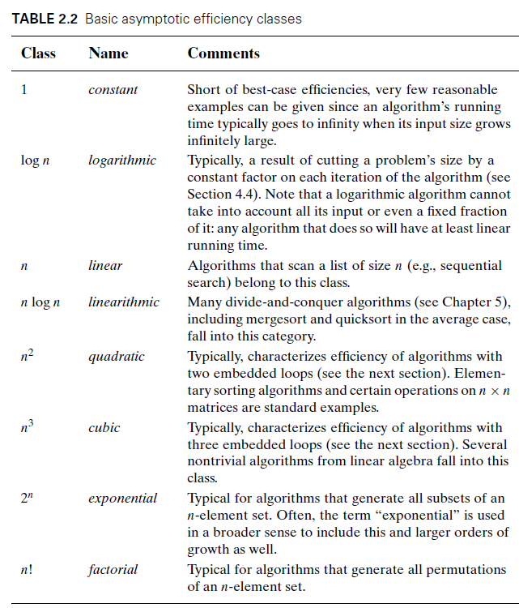

Slide 16
THANK YOU

